Slide 1

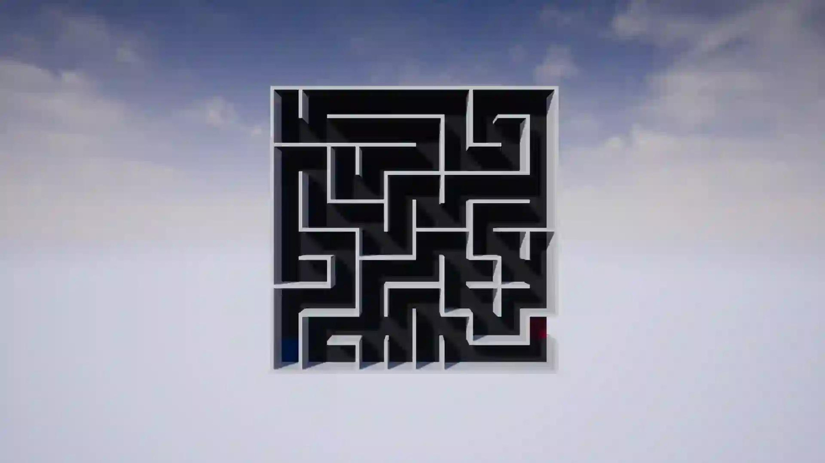
Maze generator and solver

Slide 2

participants
Abdullah Yasser 221001008
Mohamed Khaled 221000741
Zaynab Essam 221001623
Hossam Mohamed 212002446
Mousa Ashraf 221000995

Slide 3

Project description
We generate maze generator and we solve it with different algorithms (BFS , DFS , A*)

Slide 4
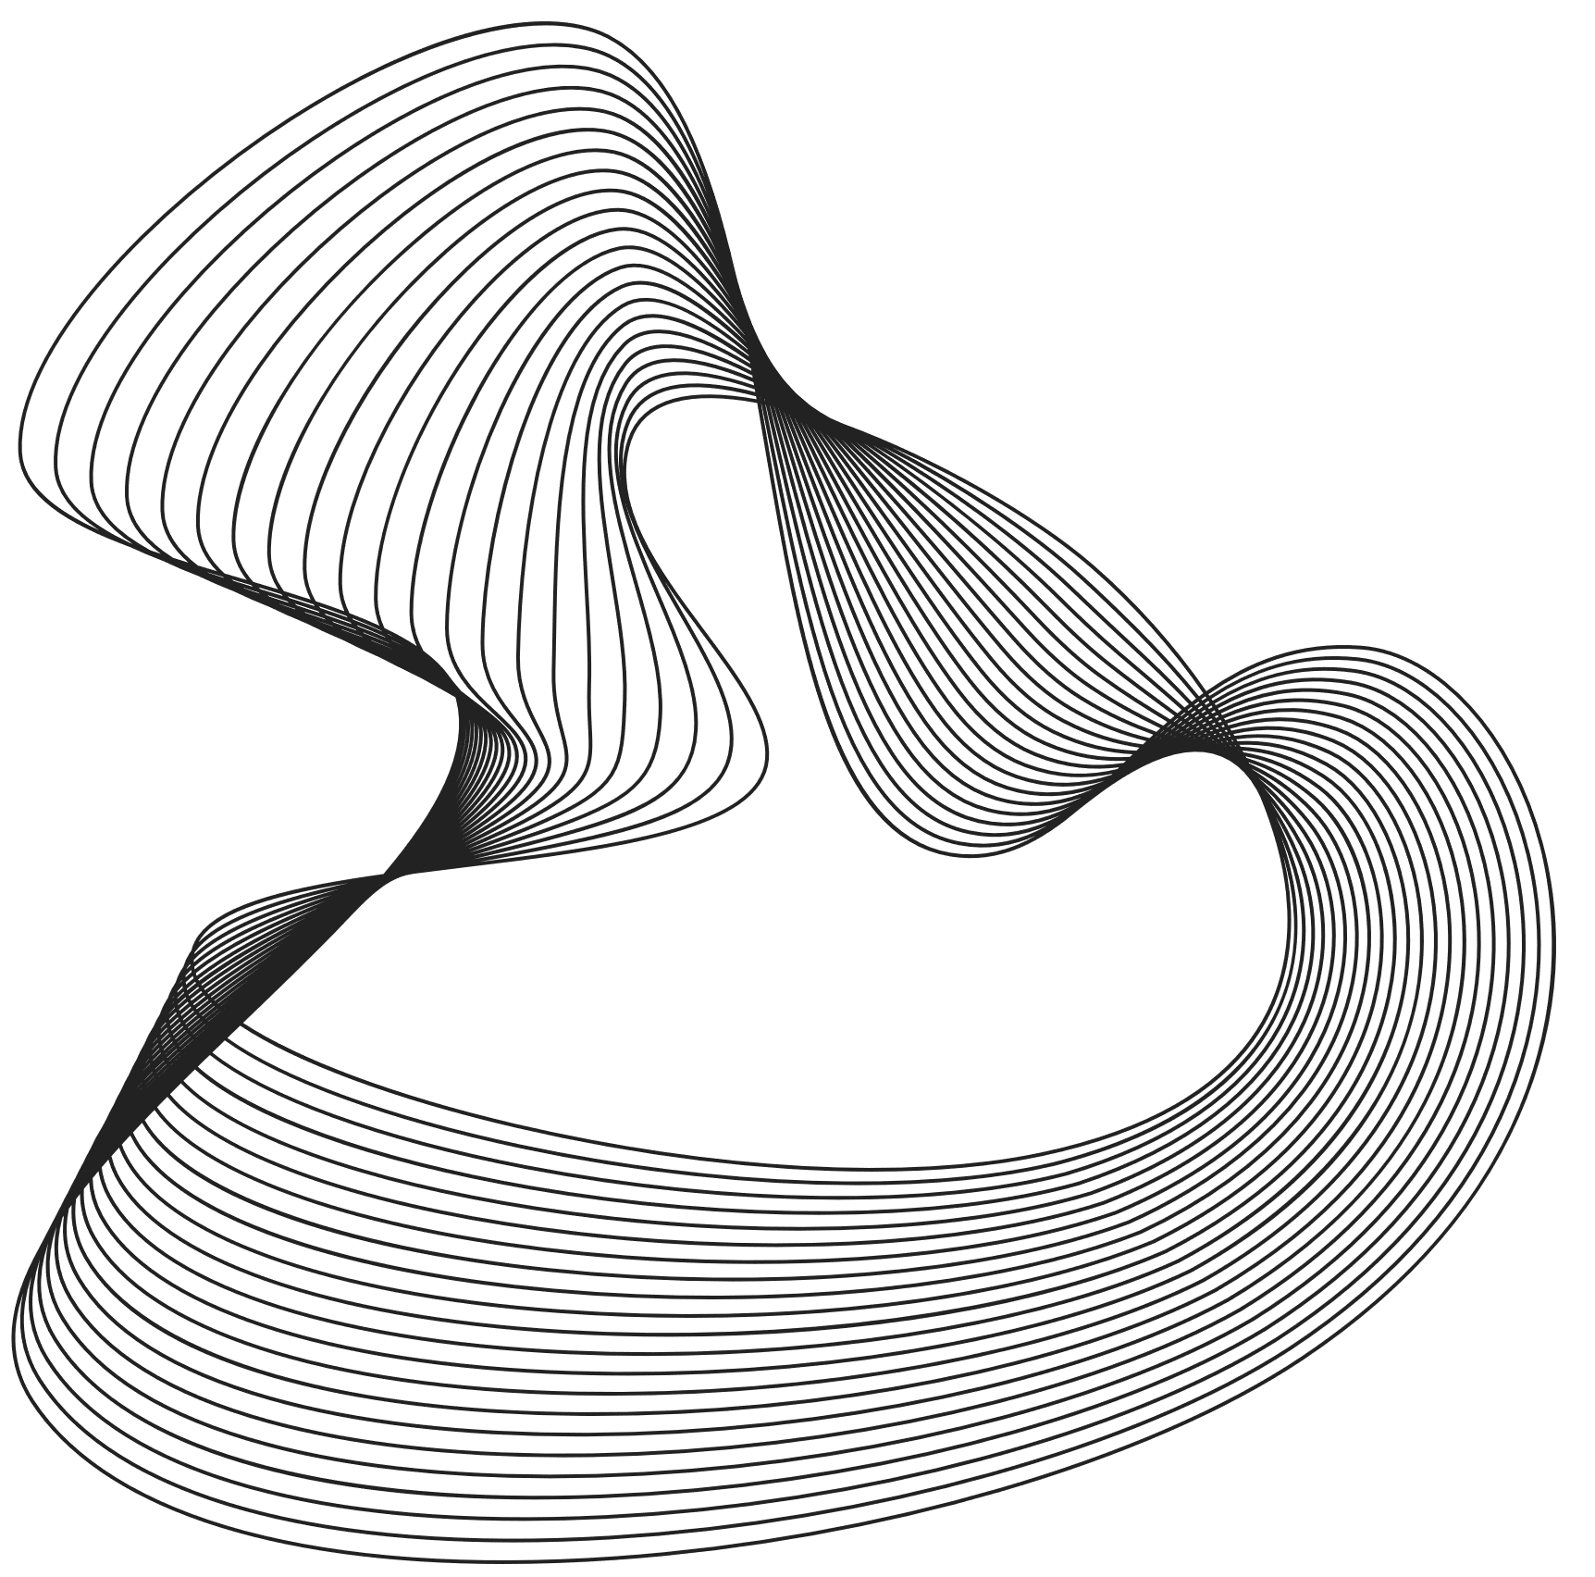
Maze Generation Algorithm
Prim's algorithm:
is a randomized algorithm used for generating mazes. It operates by iteratively selecting walls between cells and removing them to create passages, thus forming a maze.
Initialization:
The algorithm starts by selecting a random starting cell and marking it as visited. This cell serves as the initial point for maze generation.
Creating Walls:
For the current cell, the algorithm identifies neighboring cells that have not been visited yet and adds the walls between the current cell and its unvisited neighbors to a list called walls. These walls represent potential passages that can be created.
Iterative Wall Removal:
The algorithm enters a loop that continues until there are no walls left in the walls list.
During each iteration, It randomly selects a wall from the walls list. If the neighboring cell on the other side of the wall has not been visited, The wall is removed, creating a passage between the current cell and the neighboring cell and the neighboring cell is marked as visited. New walls created by this passage are added to the walls list, allowing further exploration.

Slide 5

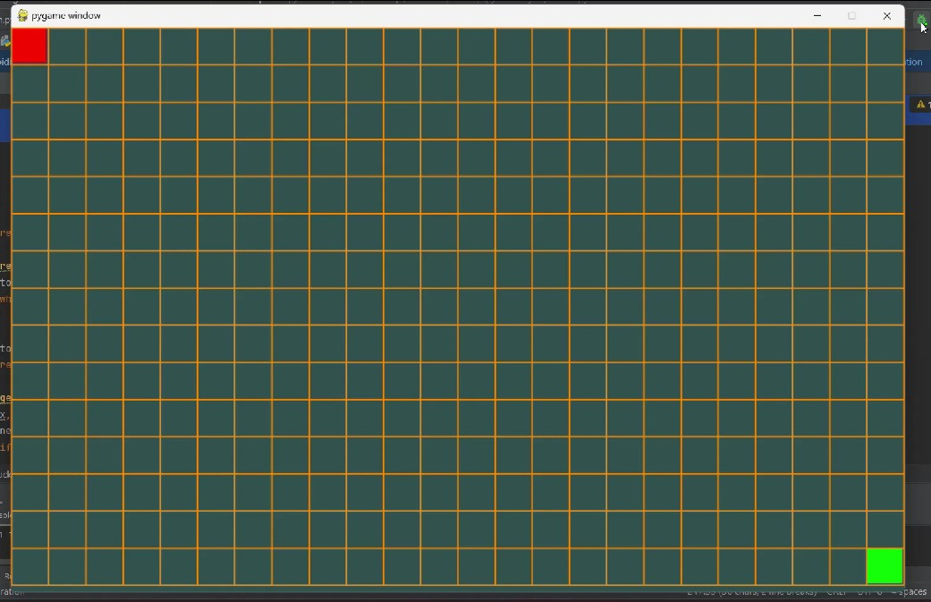
Grid

Slide 6
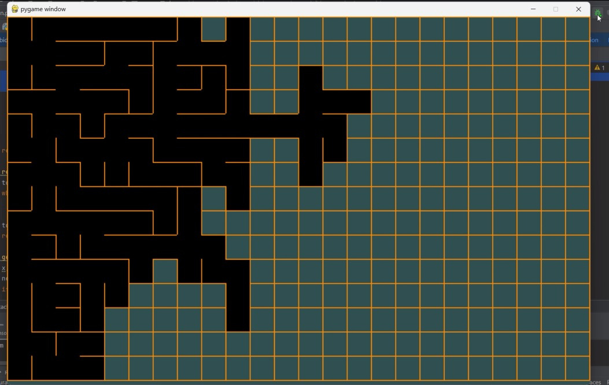
Maze Generator

Slide 7
A* SOLVE
In A* we start to create a grid of cells, where each cell represents a node in the maze. we calculate the heuristic function by using the manhattan distance between two nodes. we create a came from to store the path. The (g-score) the cost of the cheapest path from the start node to each current node in the grid. The (f-score) estimate the total cost from the start node to the goal node, passing through each node. then we check if the goal equal current then rebuild the path if not we check each of the current cell's neighbors if the g-score is best than the old g-score it's update and record it in the came-from then the neighbor is add to the open set if it is not found we continue until we reach to the goal or the open set become empty which means that is no path exist.

Slide 8
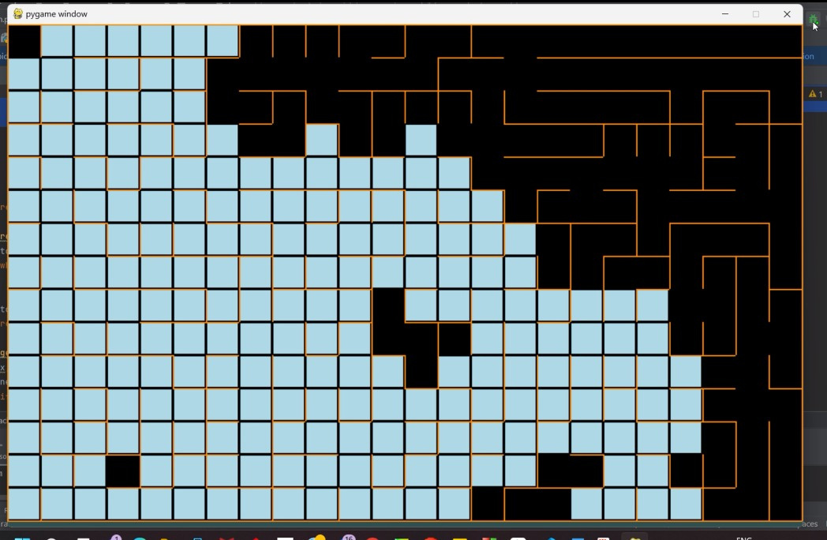

A* searching for a path

Slide 9
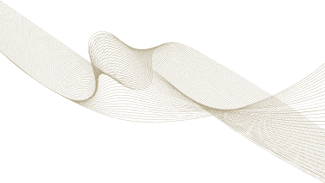
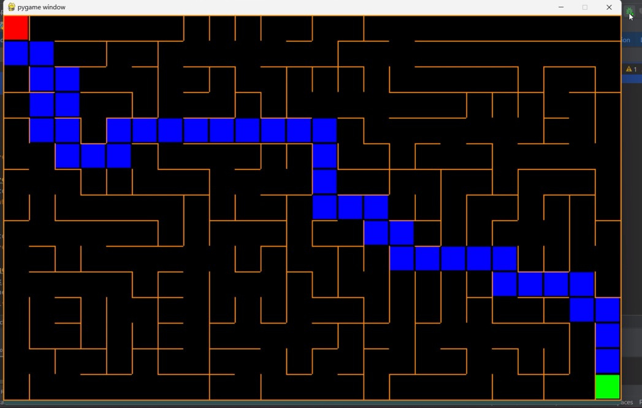
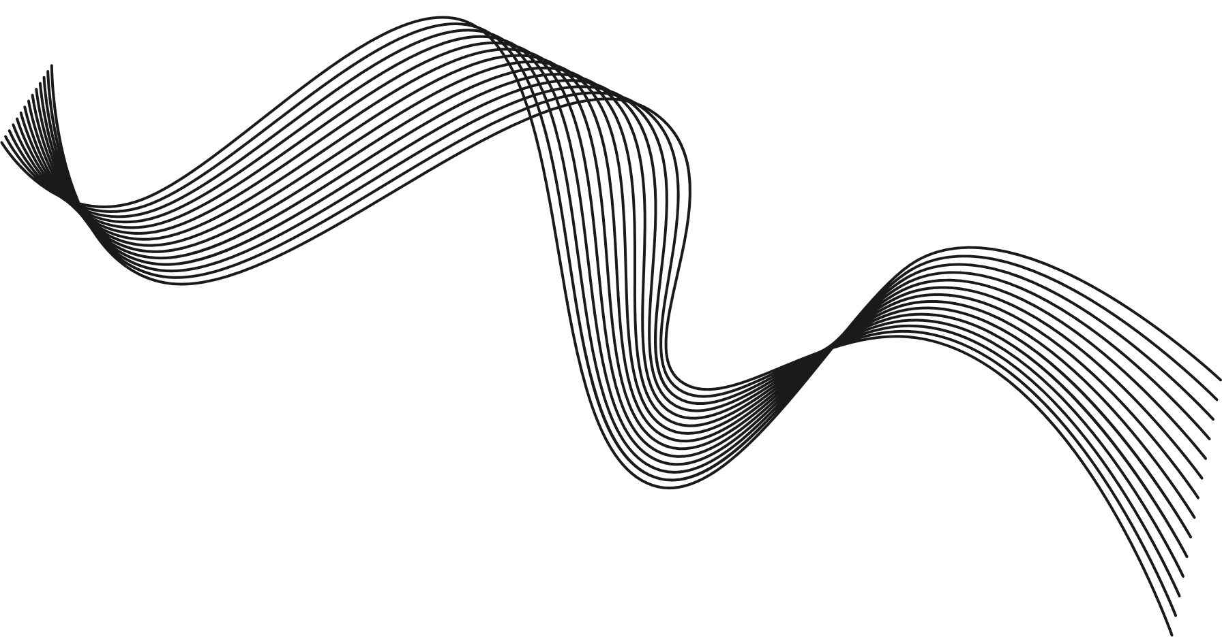

A* path

Slide 10

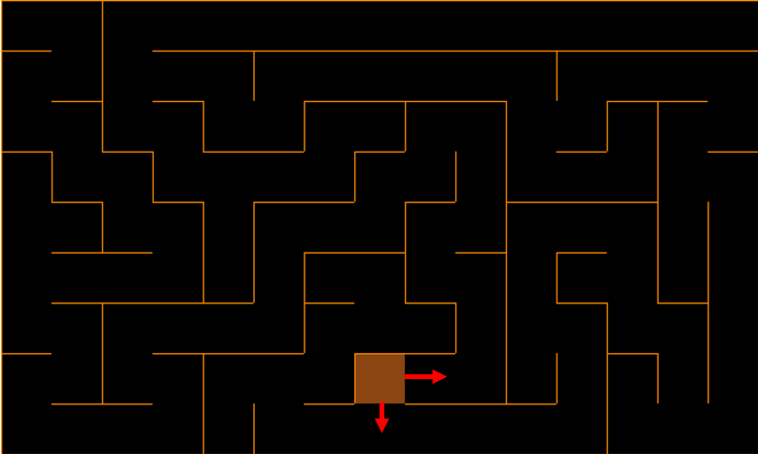
BFS Solve
How does it work?
The BFS solver algorithm works by starting from the top-left square, then choosing the next square until reaching the final square (down-right).
How does it operate to the end?
The currently investigated square (marked orange) chooses its next square by looking at its four walls (top, down, right, left). The algorithm adds to the queue the neighboring squares who have no walls separating between them and the current square (marked with red arrows), only those who haven’t been visited. After being added to the queue, those square’s previous node is set to be the current node. The algorithm stops searching when it encounters the end square.
How does it create the path?
After stopping, the algorithm implements a backtracking based on the previous node of each node. It starts with the last node going backward until the start node is reached. Before leaving each node, algorithm adds it to a queue (path queue).

Slide 11
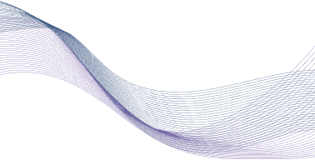
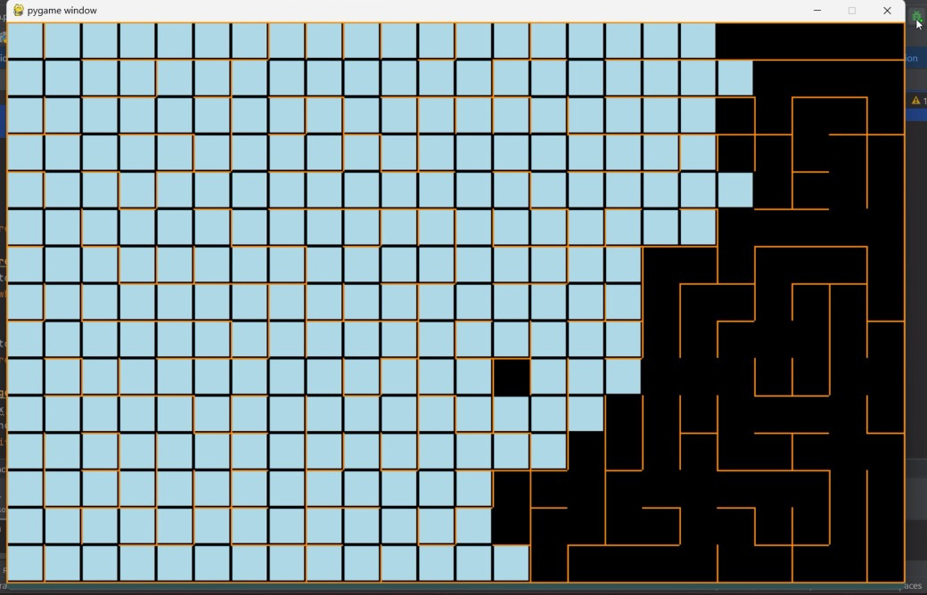
BFS searching for a path

Slide 12
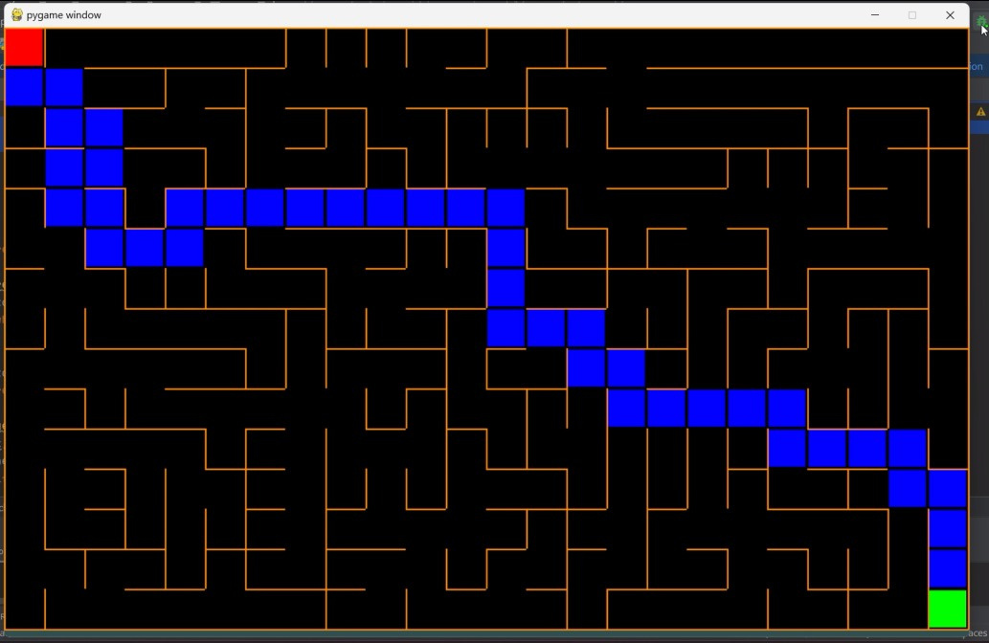

BFS path

Slide 13
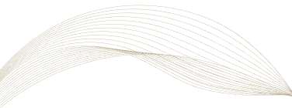
DFS Solve
what is Dfs:
The algorithm starts at a specified node (the "start" node) and explores as far as possible along each branch before backtracking. It uses a stack data structure to remember the next vertex to visit, making it suitable for backtracking when it reaches a dead end.
how it works:
The DFS algorithm for maze solving uses a stack to explore each path from the start to the goal deeply before backtracking. It keeps track of visited cells to avoid revisits, and visualizes the process by drawing the visited cells in light blue, updating the display at each step. If the goal is reached, it reconstructs the path from the start to the goal.

Slide 14

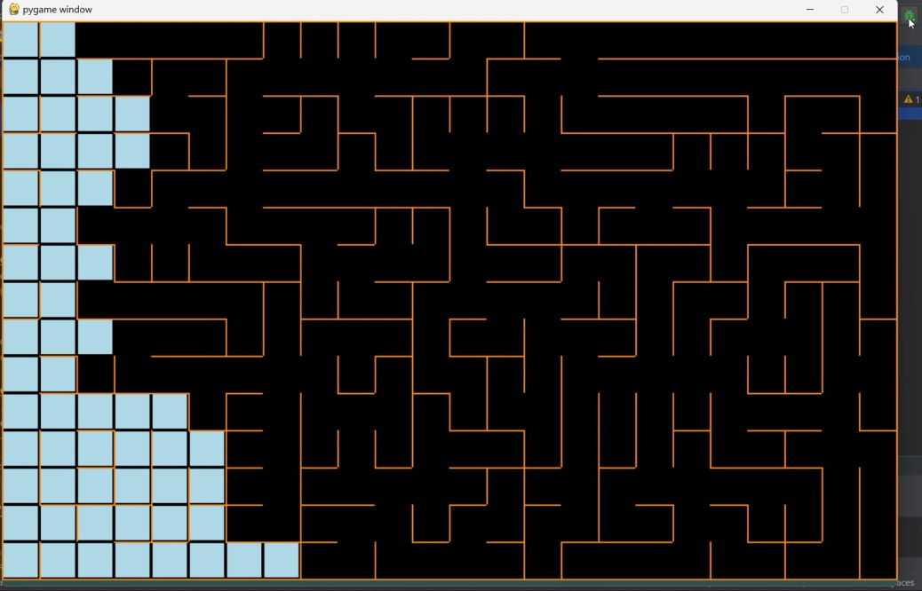
DFS searching for a path

Slide 15
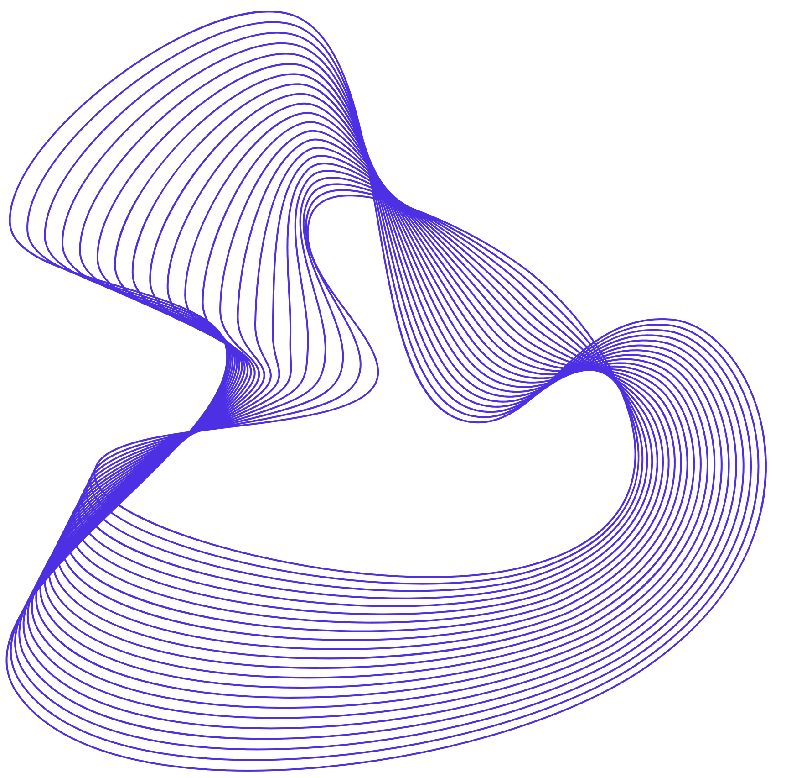
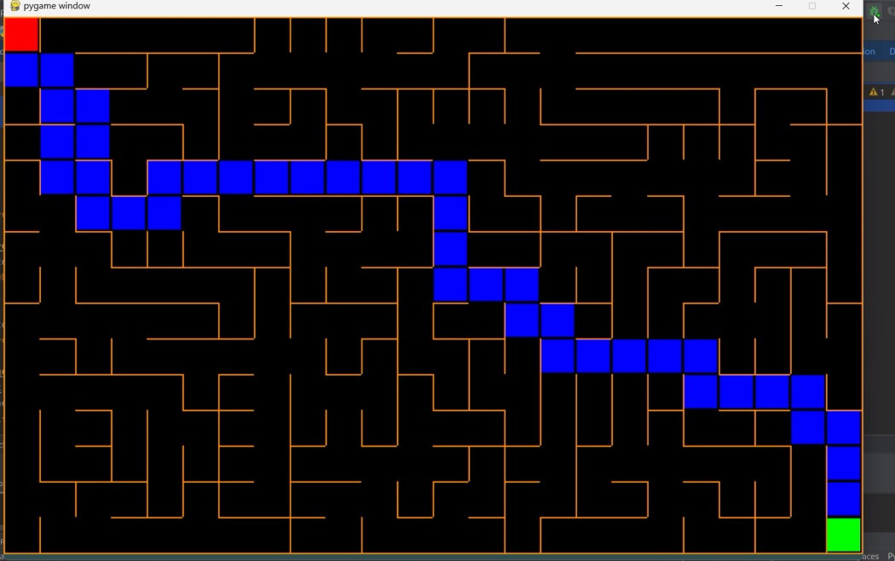
DFS Path

Slide 16
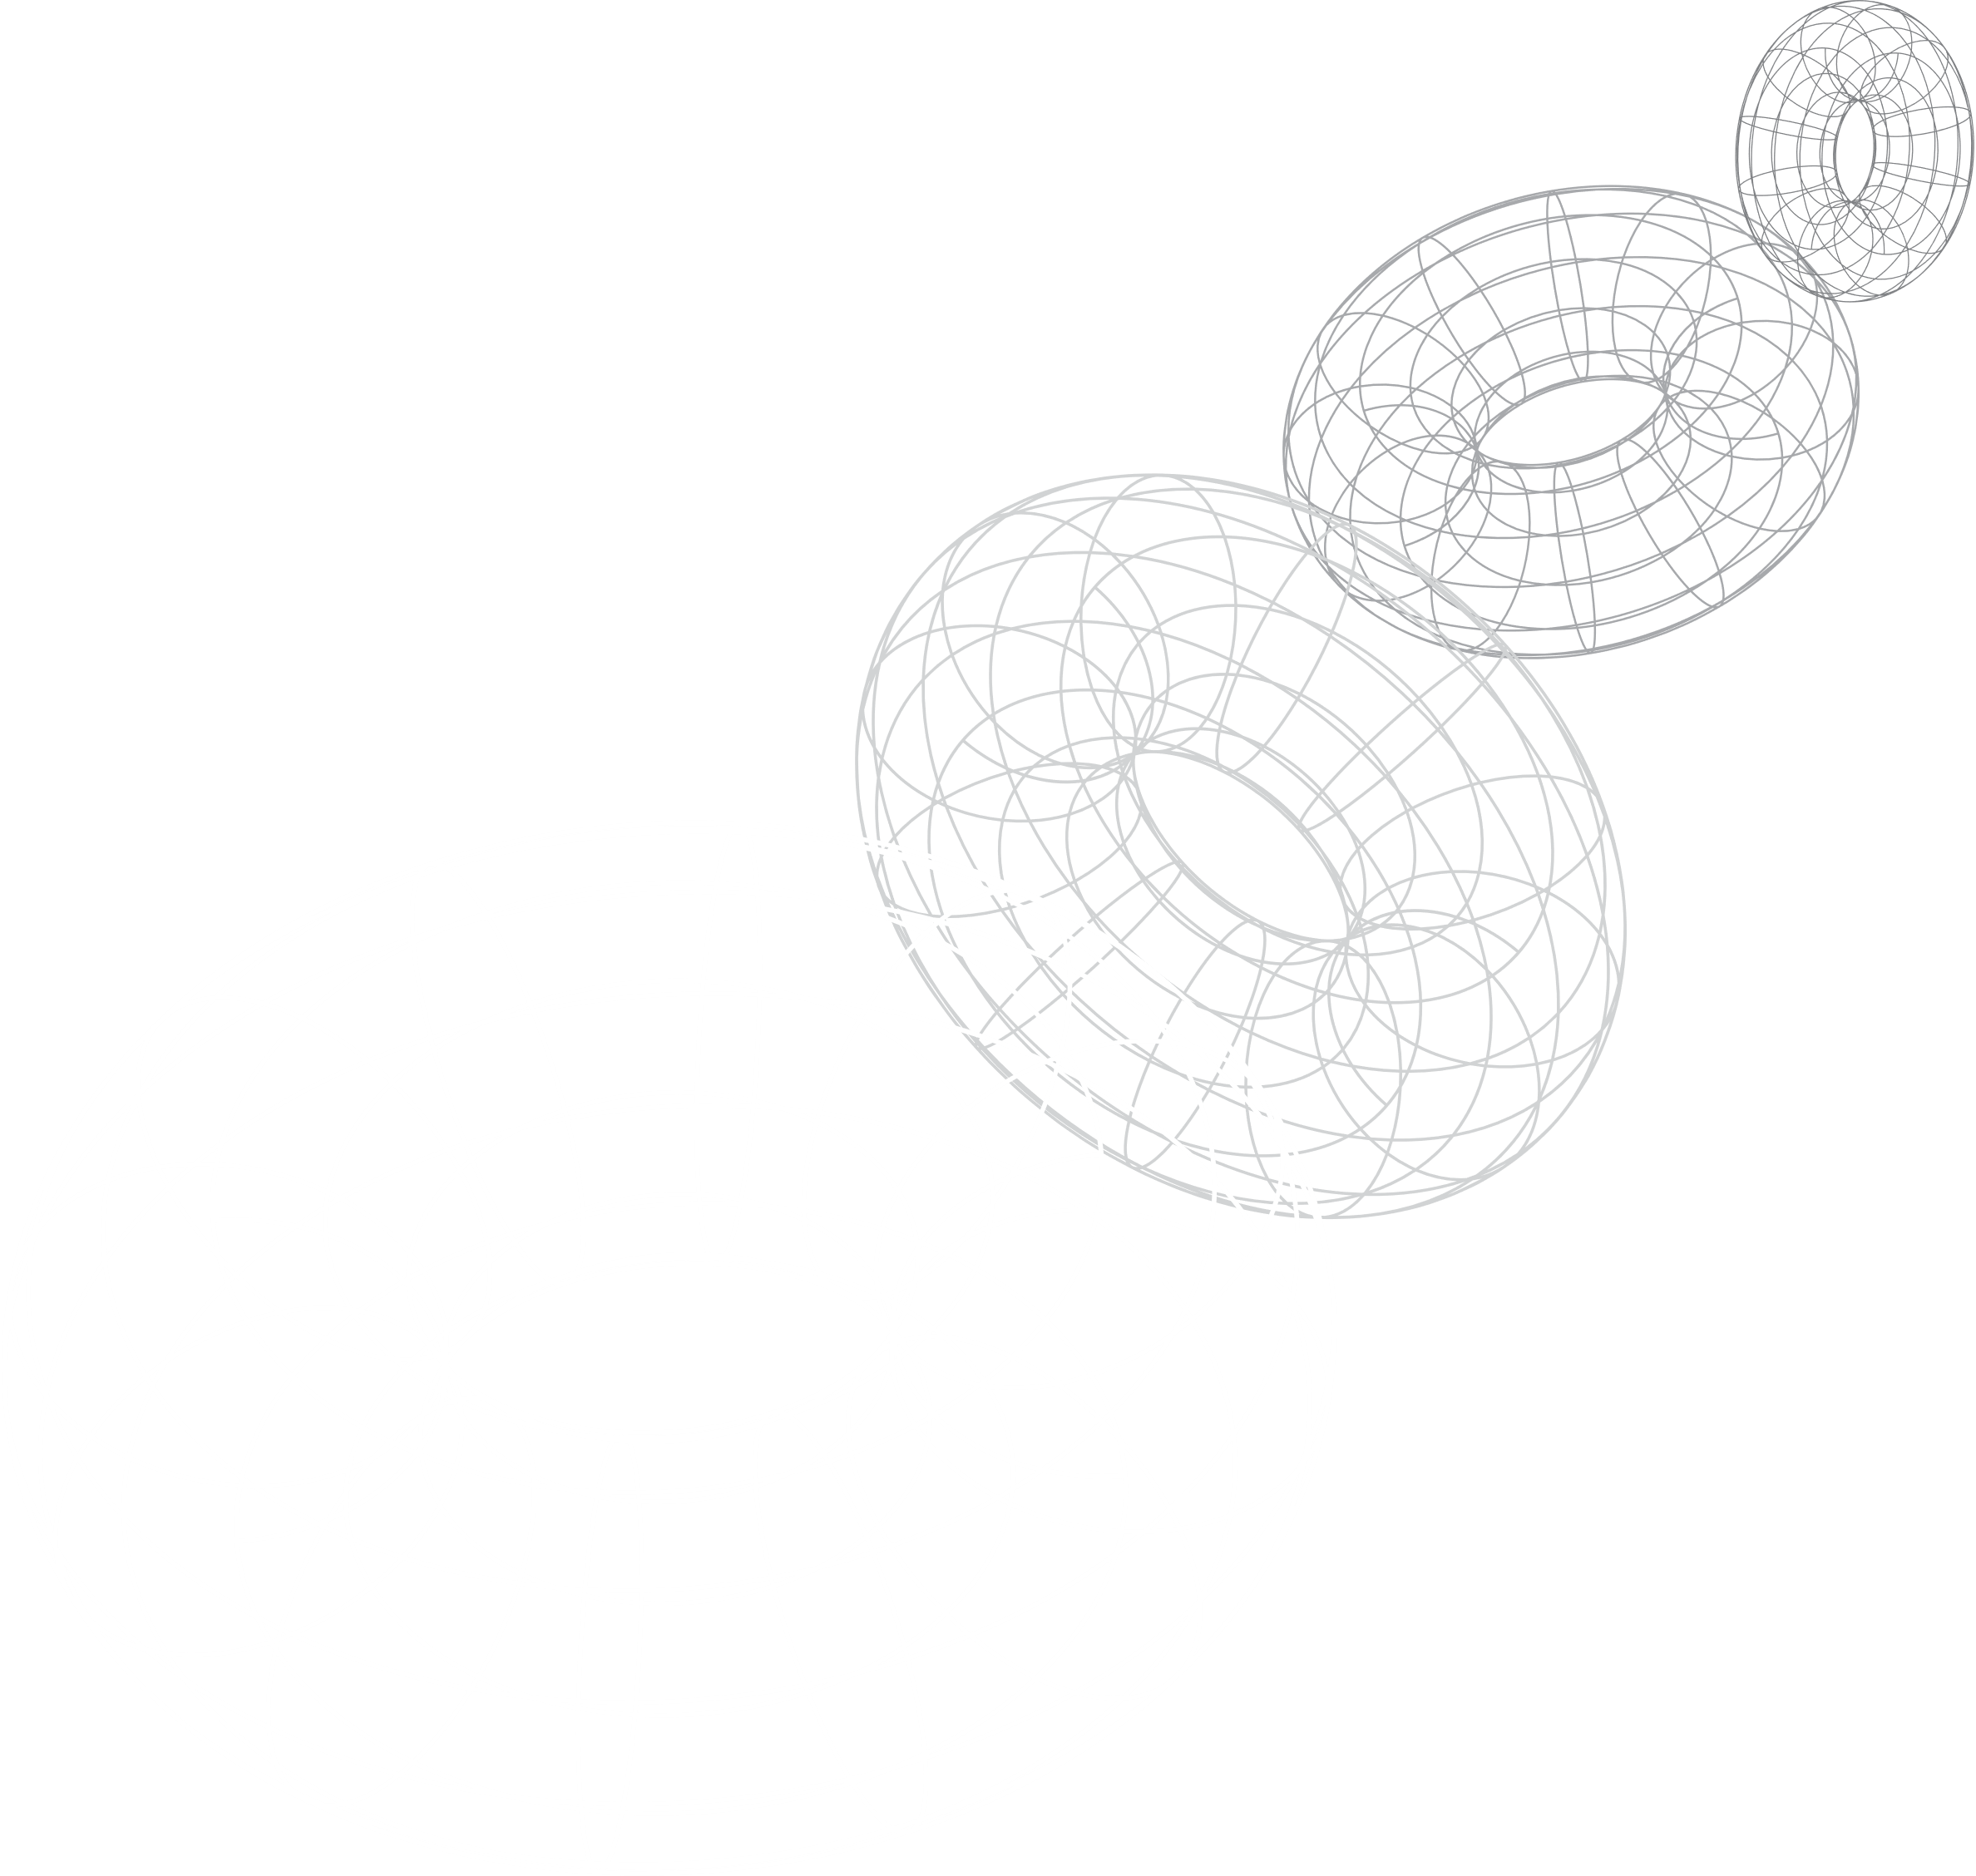
Thank You

